Slide 1
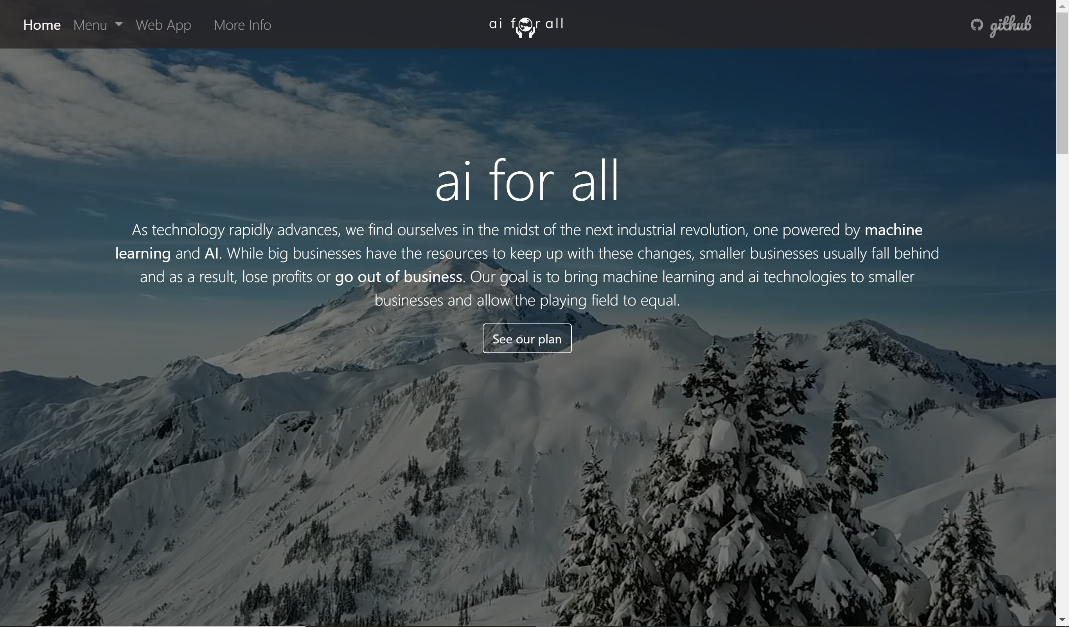
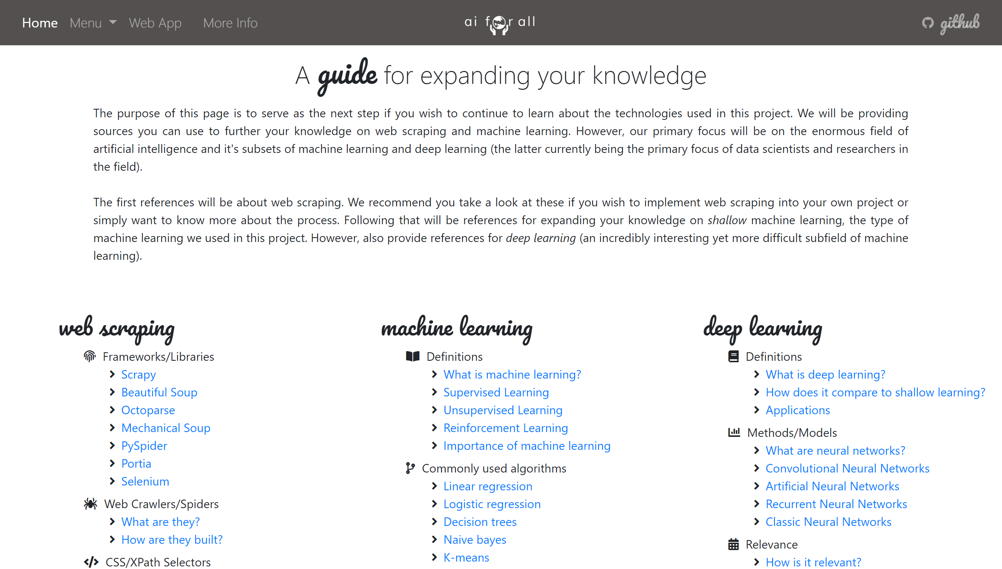
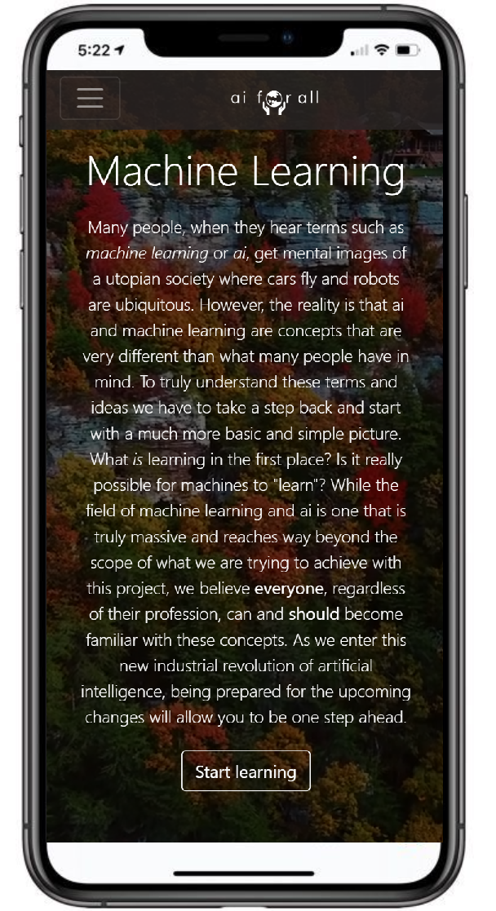
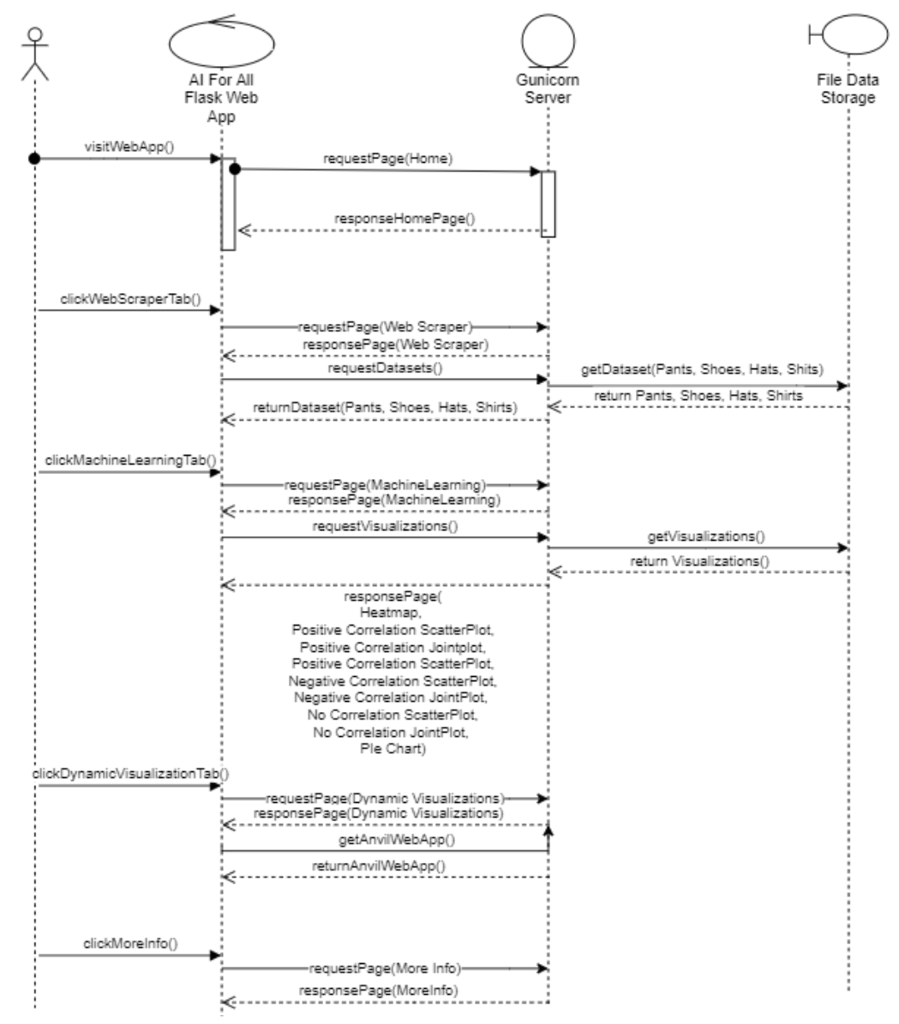

School of Computing & Information Sciences
Spring 2020 Senior Design Project
Machine Learning for Small Business Merchandising
Student: Charlie Ramirez
Mentors: Ali Zaidi, Joe Garner, Mitre
Instructor: Dr. Masoud Sadjadi, FIU
P r o b l e m
C u r r e n t S y s t e m
R e q u i r e m e n t s
Our society finds itself at a time of rapid technological advancement. As we enter a new industrial revolution, one powered by artificial intelligence, more and more people will find themselves lost in the technology driven world that exists around them. No matter our age or profession, artificial intelligence will sooner or later become a major part of our daily lives. Being prepared for these changes, therefore, is of essence.
The work we have done on this project was started from scratch. However, we would like to point out that our work belongs to a multitude of other similar works that are all part of the Generation AI Nexus, a system of artificial intelligence lessons for college students of all majors. Our project is not intended solely for college students but was nonetheless made with the intent of forming part of the Nexus.
The requirements for this project involve creating an informative lesson on machine learning and a tool that implements the lessons learned into a useful product for merchandisers and consumers. Personally, I was in charge of building our web scraper and coding our website.
S c r e e n s h o t s
Figure 1. View of homepage via desktop
Figure 2. View of our More Info page via desktop
Figure 3. View of machine learning page via mobile device
I m p l e m e n t a t i o n
D i a g r a m
S u m m a r y
Implementation of the project involved three parts: 1. A web scraper to collect data from Amazon. 2. A responsive website to explain the purpose of project, showcase our results, teach the user about the technologies used (ai, machine learning, web scraping), and guide the user to a variety of additional resources should they desire to continue they learning journey. 3. A web app (built on Anvil) that allows a user to scraper the web and view dynamic visualizations.
I was in charge of building the web scraper and coding our website.
Figure 4. Sequence diagram for Website
Due to initial complications as to what the project should become, development did not begin until sprint 2. Our team was able to use the remaining 10 weeks of allotted time to develop a total of 40 user stories and deliver a finished product that meets the standards of our project owner. We are proud to present our product ai for all and hope as many people as possible are able to benefit from it. The code is opensource with the purpose of allowing others to build on it or modify it to their particular needs.
Acknowledgement
The material presented in this poster is based upon the work supported by FIU and the Mitre Corporation. I would like to thank Ali Zaidi and Joe Garner for assistance, cooperation and mentorship that I received throughout this process.
Notes:
s

